Slide 1

SUPERSTORE PROJECT
Data analysis on maximizing sales and profit
Presented by:
Esther Reginald yeboah

Slide 2
Content
Background
Problem Statement
EDA Findings
Recommendations

Slide 3

BACKGROUND
Who we are

Slide 4

Who we are:
We are a multinational retail company we deal in the sales of office supplies, furniture, technology equipment and accessories. We have stores in 7 markets; Africa, APAC, EMEA, EU, US, LATAM, Canada with 13 regions under their umbrella.

Slide 5

PROBLEM STATEMENT
We are a multinational retail company and have decided to embark on a campaign called 'Operation Increase Sales and Profit' (OISP) which focuses on increasing the sales of the company and maximizing profit.
Before the management team of the company can take any actionable decision with regards to this campaign, they want to draw the necessary insight from the existing data the company gathered.
Operation Increase Sales and Profit' (OISP) is a campaign proposed to turn the numbers around.
This analysis will show the ways we can explore to achieve this goal.

Slide 6

EDA FINDINGS
The description of the data we are working with.
The findings
The summary visual story board

Slide 7
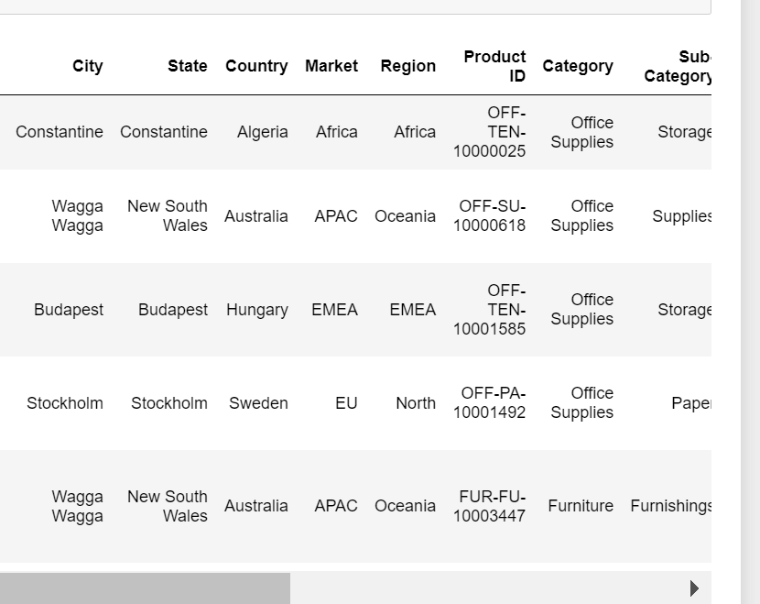
DATA
51,289 observations
13 Variables
7 featured variables
15 Categorical variables
7 numerical variables

Slide 8
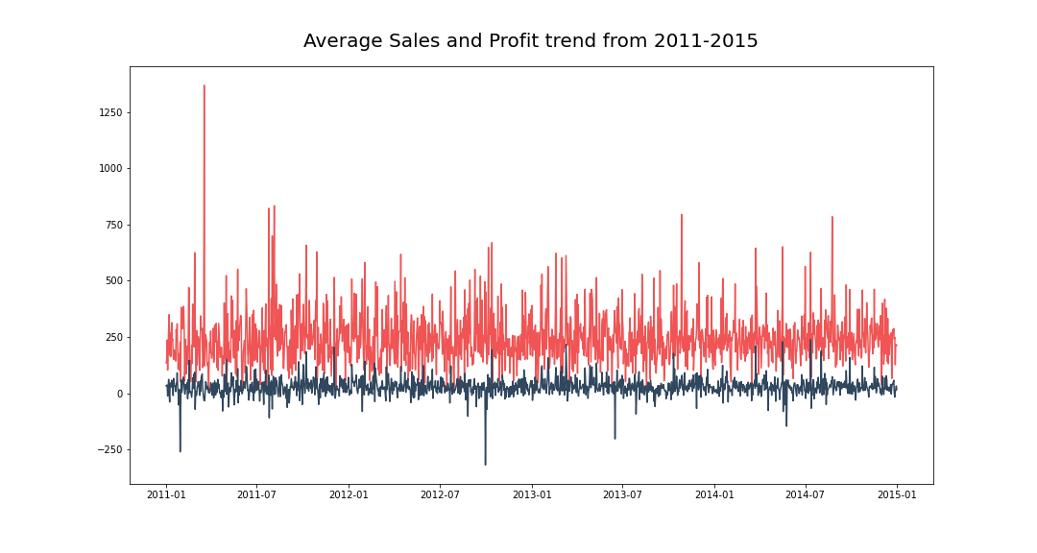
FINDINGS
The trend is very consistent and has maintained the same range of sales and profit for 4 years.
There are negative in our profit which equally means losses.
We have few outliers in sales which did not translate to profit.

Slide 9
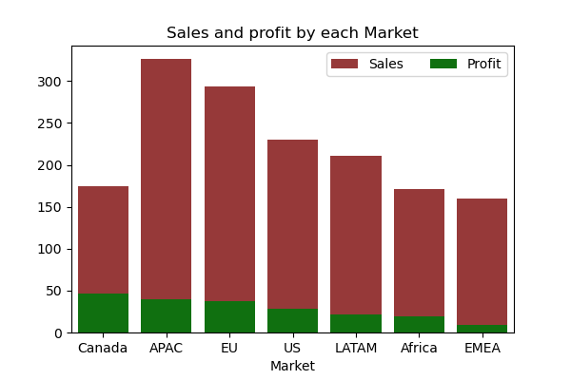
FINDINGS
APAC generates the most sales followed by the EU.
However, Canada generates the most profit while EMEA generates the least.

Slide 10
FINDINGS
39% of the items sold according to our data was below a general average advised profit margin.
This could have been caused by a lot of factors; from low patronage, obsolete items, hyper-competitive industry, cost of goods, high discounts etc.
These factors should be fished out (when we get data that can help) and then we can increase our profit margin to make more profit.

Slide 11
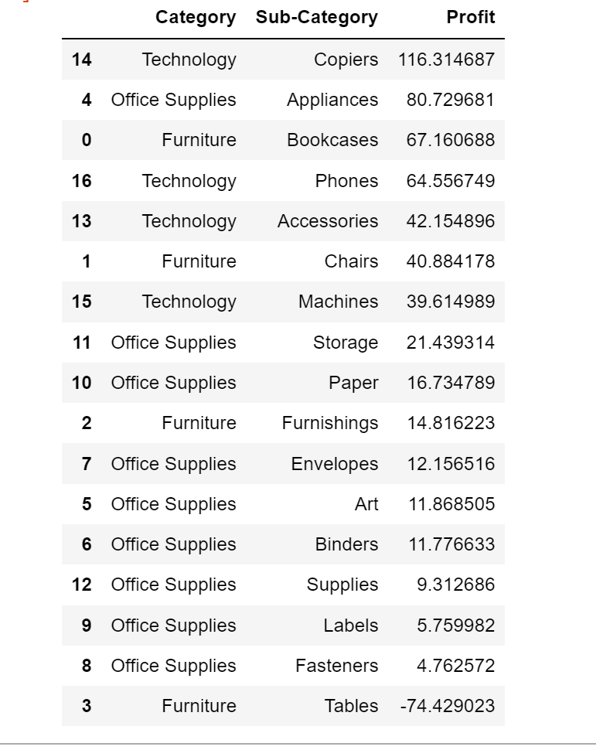
FINDINGS
Copiers are the most profitable of all subcategory and so is the technology category
Tables causes us to loss. This can be due to several reasons; style, quality, market etc.

Slide 12
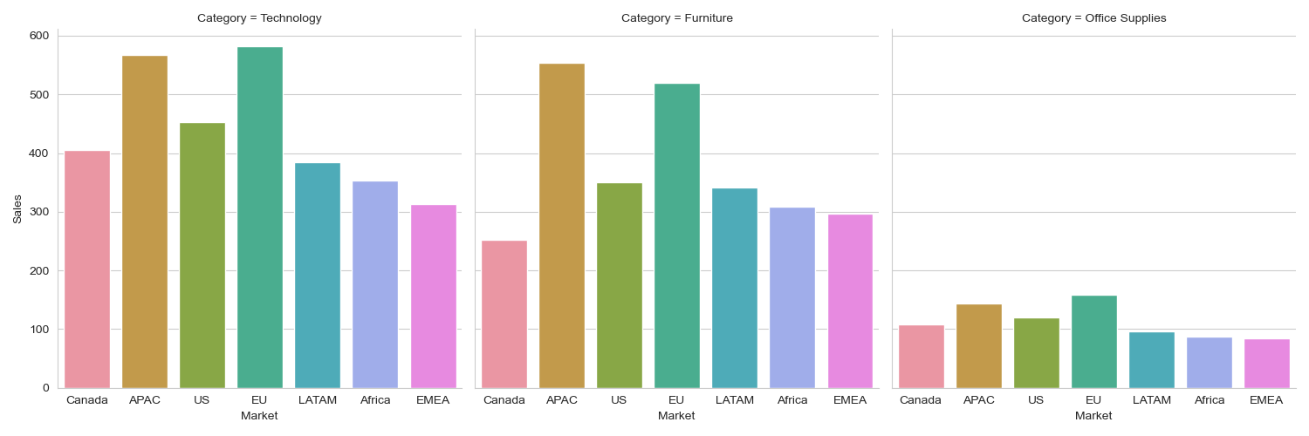
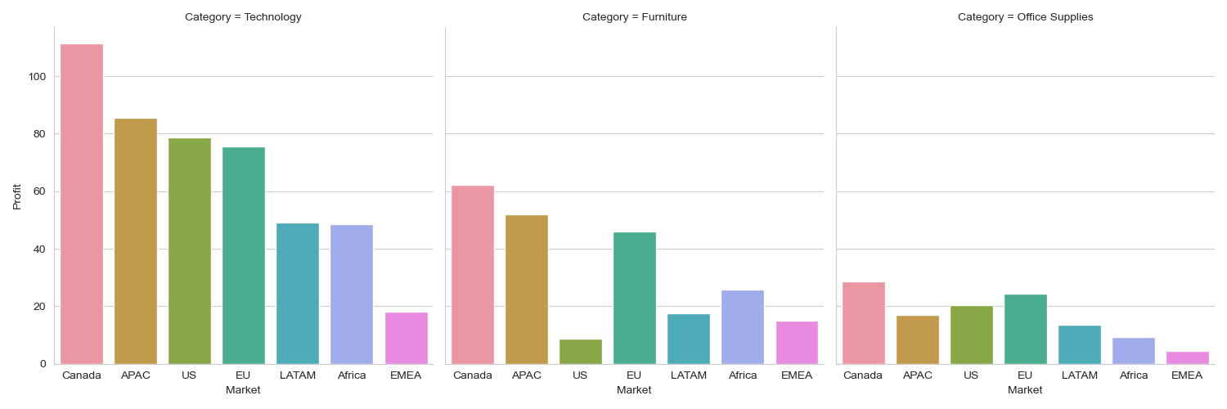
FINDINGS
Although Canada is not the highest in sale, it is in Profit. This suggests that Canada must have been selling highly profitable items and these items should be encouraged and boosted for even more profit. These items are in the technology category.
EMEA on the other hand is performing way poorly, It needs a boost either through advertisement, higher discounts and tailored products like investing in furniture and Technology category

Slide 13
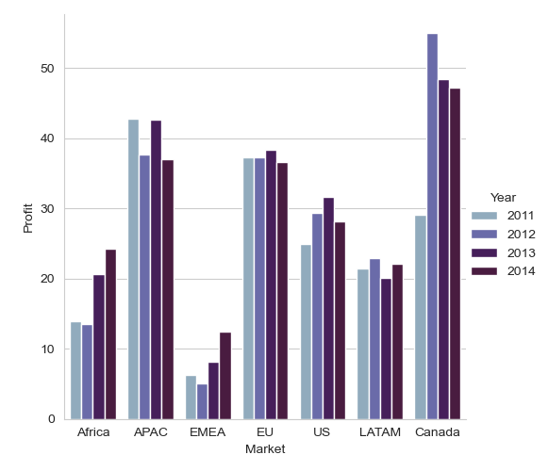
FINDINGS
It is good to notice how the Canada market is gradually going down over the years. This could be a short time slope or a profit margin problem from the discount.
On the other hand, since there is a sign of growth in the EMEA market, more investment in advertisement or discounting could even push it further.

Slide 14
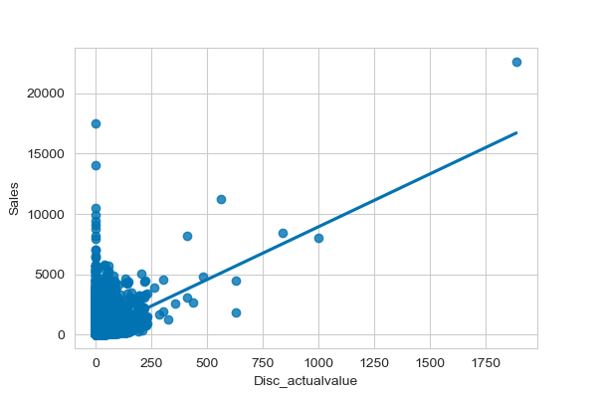
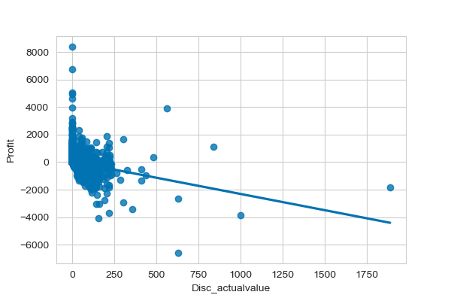
FINDINGS
DISCOUNT VS SALES
There is a positive although not strong correlation among these variables (sales and discount). This case may likely be that some part of the sales may be responsible for this spike.
DISCOUNT VS PROFIT
There is a negative correlation between profit and discount which in effect discount is causing the company to loose.

Slide 15
Recommendations
SO, HOW DO WE INCREASE SALES AND PROFIT?
Increase profit margin: Since 39% of our orders were sold below the standard profit margin of 10-15%, we can assume that most of our products are undersold. Therefore increase the prices of these products especially in markets that are already doing very well.
Discounts should only be applied to market’s where it can help boost sales like the EMEA and Africa. Also, discount should be given at some specific periods of the year and not all year round to avoid losses. Discount should be tailored to only under purchased goods to encourage sales.
More profit can be generated when each market focus on their niche than just getting a regular distribution. Also, cut out products that earns below average profit in each market.
In addition to this, since technology is the most profitable, more items in this category should be distributed across the markets, low categories like Tables generating loss should be less supplied for sales, and the ones performing averagely can be boosted with discount or advertisement.

Slide 16
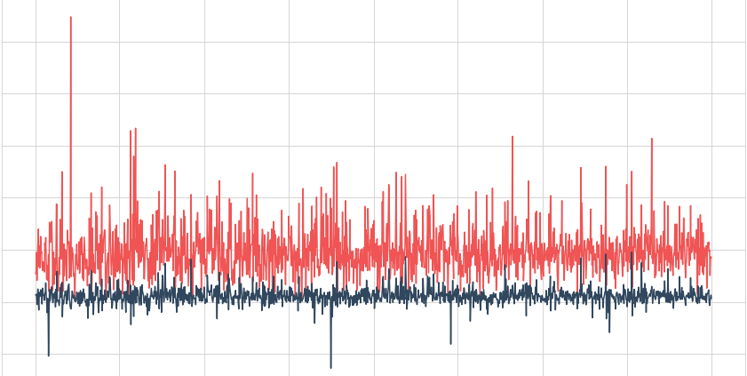
THANK YOU FOR YOUR ATTENTION
ESTHER REGINALD YEBOAH

